Slide 1
SoK : Can NFTs Solve The Economic Problems of Countries with Ancient Heritage? Egypt as a Case Study
Shymaa M. Arafat
shymaa.arafat@gmail.com, shar.academic@gmail.com

Slide 2
Motive
Why don't debted countries make money from Cryptocurrencies & DeFi ???
Notes:
A lot of voices around the world, and papers also, discussed the question how can developing countries made money from Cryptocurrencies? The current circulating Bitcoin and Ethereum worth value can pay some countries all debt

Slide 3
Agenda
Countries & Cryptocurrencies
NFT usages in arts & donations
NFTs & Metaverses in museums and cultural
Egypt case
Challenges & Design Decisions
NFT developers view.
Conclusions
Notes:
To answer this question, a scan of as much as possible of all online and literature material was to needed to produce this taxonomy about the subject, and I will give you a brief on all the of the following topics

Slide 4
Other countries Experiences
Mining
Banning ➡️ China, Malysia
(Fear of ransomware, criminal activities, Ponzi schemes, energy consumption, carbon footprint)
Notes:
Let's explore what other countries have done -The first thought was mining, between social mediavoices and some reports about Monero mining (alt coin to Bitcoin, but with more secrecy), we only have an explicit statement from Worth Texas mining Bitcoin . -Then repulsive Banning Ethiopia, China after hosting major mining pools (but still having an NFT-Metaverse project), Malaysia published a seen of destroying $1.5 bn worth of mining devices . -Fears: Effect on fiat currency, ransomware & criminal activities due to anonymity (sometimes opposition fund, recall human rights grant to Utreexo) +Electricity consumption & environment criticisms

Slide 5
Other countries Experiences
Bitcoin Adoption ➡️ Selvador
Problems ❎ we don't want that
»»»Advantage
Tourism is up by 30%, have attracted a lot of people from the crypto community; other countries spend bns in marketing campaigns ✅✅✅
Notes:
-Countries adopted Bitcoin as main currency Venezuela, West Africa, ..., let's talk about the most recent experiment on Salvador . -Problems in Network readiness (errors), people willing (just used the incentive startup money), affected by last price drops. . NO NO, that's all too risky & also volatile, we do not want to suggest that . -one Benefit: Adding youth tourists who only use crypto money. »»»Yes we could use that

Slide 6
Motive ...
NFT world trading volume'21 is $55 bns
(https://www.pwc.com/gx/en/industries/tmt/media/outlook/outlook-perspectives.html)
Metaverse is $210 bns expected to hit 730 by 28
(https://www.fnfresearch.com/sample/metaverse-market)
Notes:
Then, what about NFTs? & there role in games & Metaverses???? If Governments collected money through NFTs & Metaverses that's not risky and doesn't include all of these problems... And we can make it eco-friendly

Slide 7

Where is Egypt (1/3 world ancient heritage) share of this Pie???
Notes:
-Don't we have 1/3 of world ancient heritages? -Don't we have ancient civilizations with a lot of fancy legends to tell & use in games? don't we have artists who can create suspense in that? -Don't we also have rare coral reefs in Red Sea that we can use in a lovely Metaverse, and also archive before deterioration?

Slide 8
NFTs in arts & Celeberties (Entertainment Business)
Games : Cryptopunks, CryptoKitties,
Axie : ➡️ Phillipines ❎ (we don't want to repeat that)
Beeple pic ~ $69 ➡️ Paintings
Musicians
(Fans clubs, tickets, advantages,..., royalties)
Johnny Depp "Never Fear Truth" ~ $800k
Nelson Mandela "My Robben Island"
Notes:
-NFTs started with Games like Cryptopunks & crypto kitties ( earlier trials with Bitcoin colored coins or skins didn't continue) -We all heard about Beeple pic., a chance to young/infamous art creator, just like YouTube and other platforms introduced a chance to talented show creators -Artists, celebrities got the idea and went with the flow quickly since they're used to commercial uses of selling their posters, digital records; handling social media & digital environments in general -NFTs evolved to add benefits to buyers like tickets discounts, exclusive lives with the celebrity,... & also royalties to the creator to get a ratio of each resell. -Events, scoops, or whatever attracts the media was used to example johnny deb

Slide 9
NFTs Cultural & Community
Yale University "Statistics & Data Science"
NGOs: women(Tigray, Egyptian in debt)
US Constitution rare copy $43.2m
Museums joined the club
The point is museums don’t sell anything, they just grant the use of the image

Slide 10
Musuems NFTs
State Hermitage (Russia) $140,000
Ukrainian musuems loss donations $440,000
England (British museum, WitWorth, Manchester, Liverpool "crypto connections",..)
The Belvedere (Austria)
USA (Moco, Aspen, Data History Artifacts, Hip Hop Museum,..)
Himalayas (India)
Museum of the Future (UAE)
Italy (Uffizi & 8 more galleries) ~ $80,000/DAW
Notes:
I guess before Metaverse all museums NFTs summary table

Slide 11
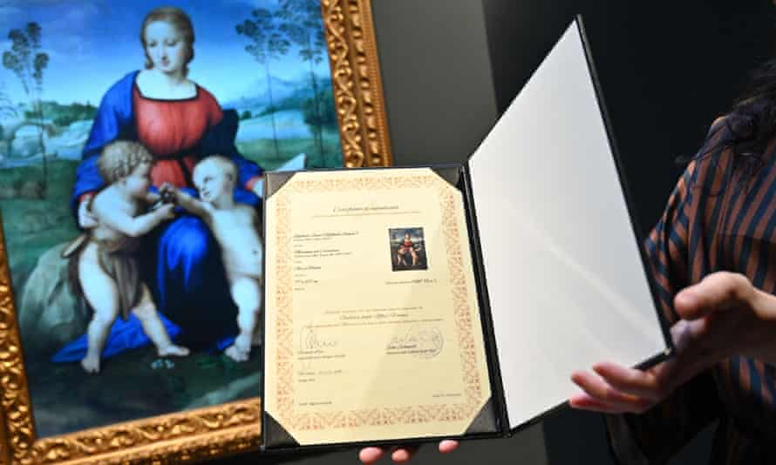
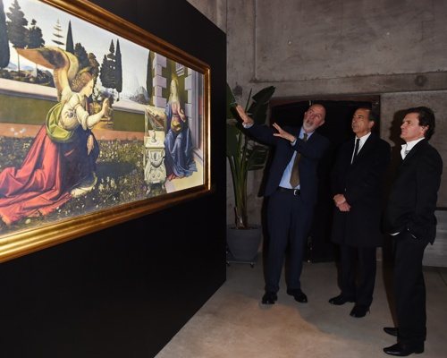
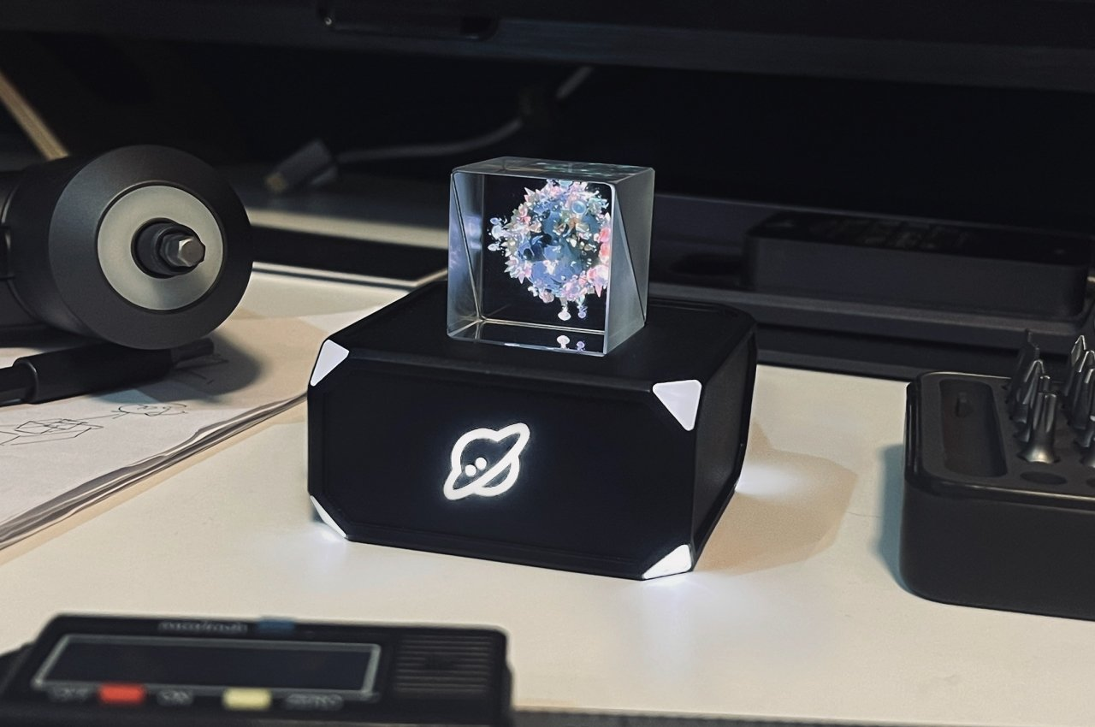
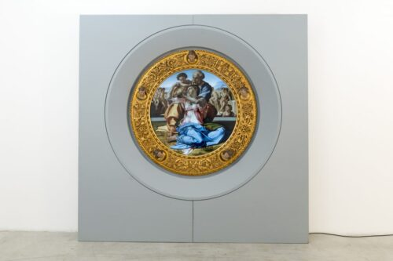
What are DAWs? Why halted in Italy?
Notes:
Before I go to next point, let me brief you about DAWs as a some what different and very expensive 3D NFTs that need to be connected to a Computer -The advantages of Tours ( different than the physical object, provide more, & could be used for mummies in Egypt provides better than true object) -Problems of cost happened in Italy . -Italy found that the museum took only 1/3 of the selling price (80,000$ from 240,000$) -DAWs from Cinello are not just regular NFTs, they're only minted to the Blockchain on customer request to add more authenticity . -Profit & revenue from exhibition tours without bringing the physical painting (Saudi Arabia, then London)

Slide 12
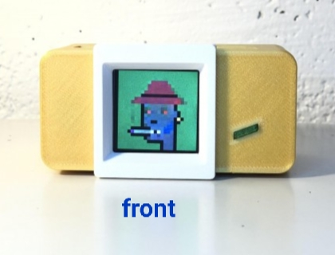
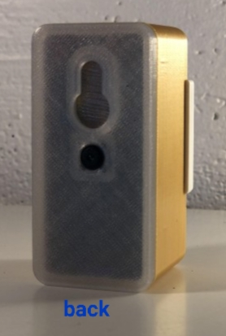
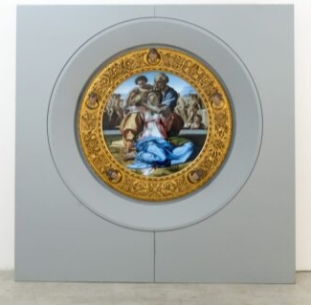
NFT viewing hardware
a Doni Tondo DAW®
From Uffizi
3D Holographic
Notes:
-There are special NFT viewing hardware devices, 2D & 3D

Slide 13
What are DAWs? Why halted in Italy?
Notes:
-Italy found that the museum took only 1/3 of the selling price (80,000$ from 240,000$) -DAWs from Cinello are not just regular NFTs, they're only minted to the Blockchain on customer request to add more authenticity . -Profit & revenue from exhibition tours without bringing the physical painting (Saudi Arabia, then London) . Ethereum Blockchain is used

Slide 14
Metaverses added Extra Merits
$500m bought VR plots in 22 (WEForum)
Fashion brands NFTs
➡️ could join with ancient Royal Jewelries
Joint International Metaverse projects
Learn to Earn Concept
Morpheus project

Slide 15
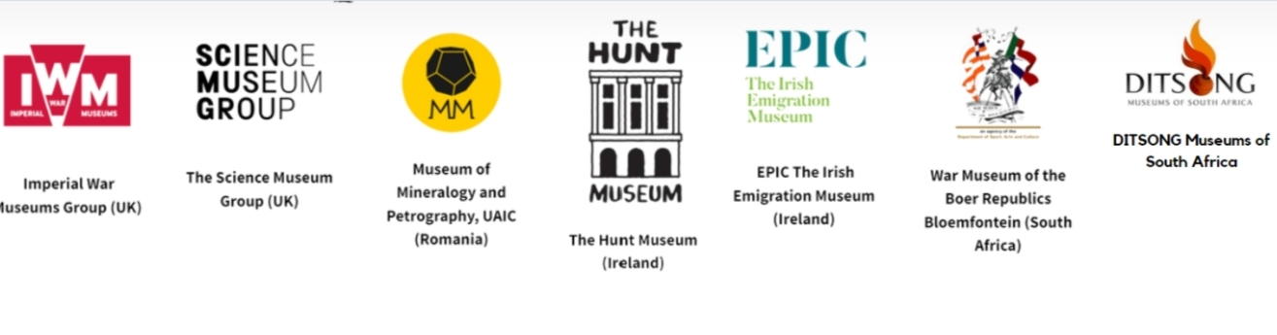

The Morpheus Project

Slide 16
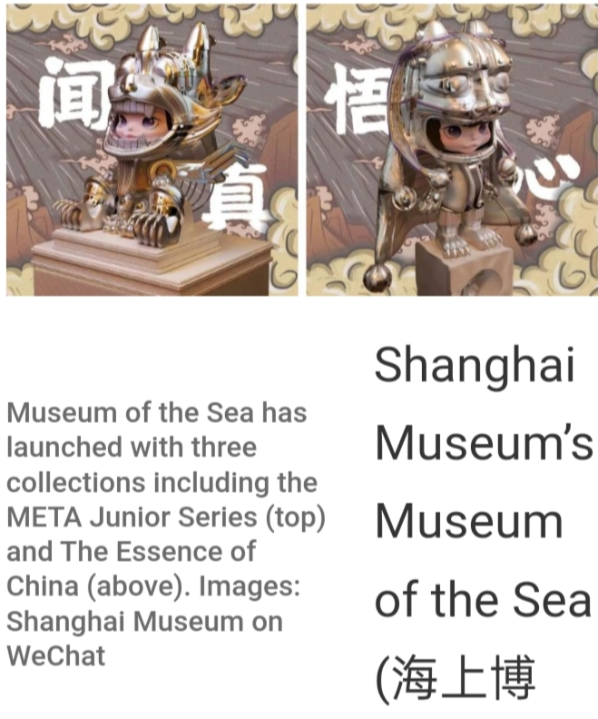
Other Countries Big Investments
South Korea ($200m)
UAE ($54m)
China
Notes:
Countries with heavy investments include South Korea, UAE, China in Shanghai in spite of the crypto banning . -Before I go to next point, let me brief you about DAWs as a some what different and very expensive 3D NFTs that need to be connected to a Computer -The advantages of Tours ( different than the physical object, provide more, & could be used for mummies in Egypt provides better than true object) -Problems of cost happened in Italy

Slide 17
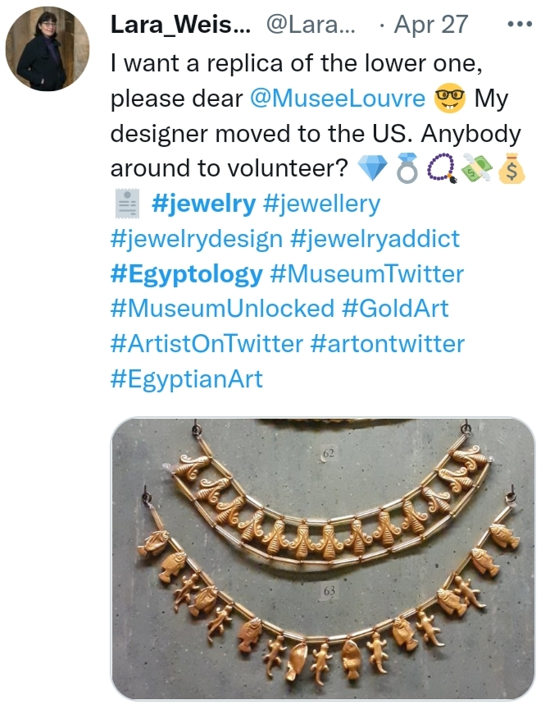
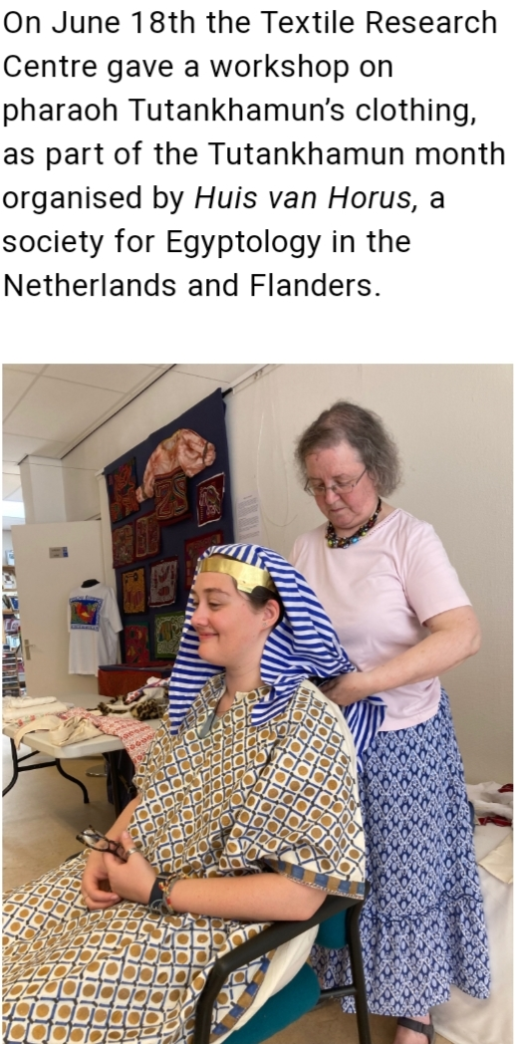
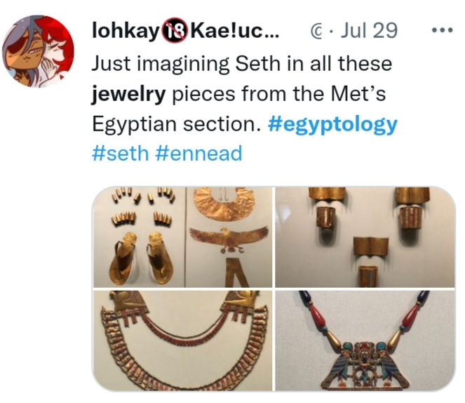
Suggestions for Egypt
Sell/rent NFTs (renting NFTs is possible; EIP-4907) NFTs of ancient royal jewelries & custom clothes in existing Metaverses (ex. Roblox)

Slide 18
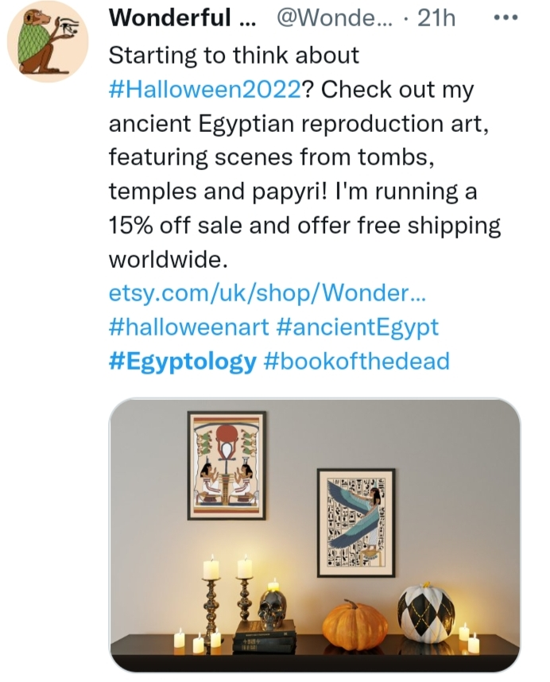
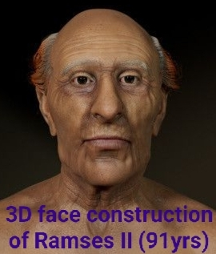
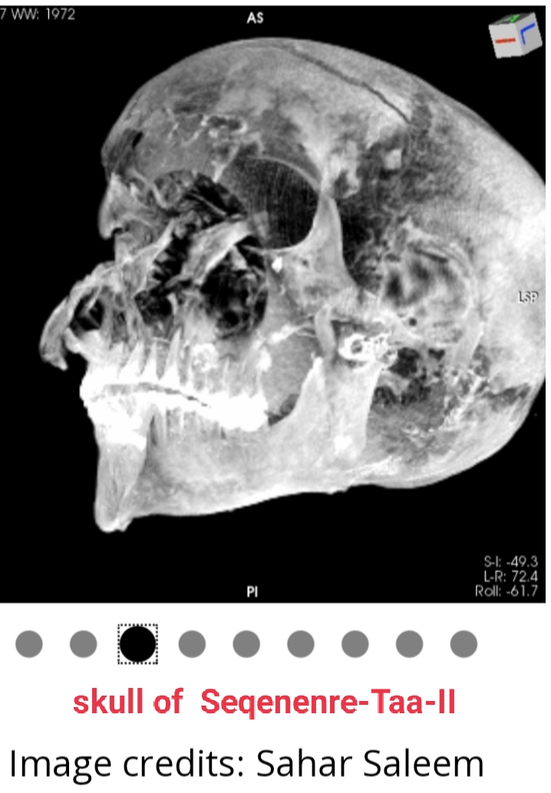
Suggestions for Egypt
Sell different varieties of souviner NFTs
Make/sell DAWs of specific items for tours and educational purposes (unwrapping mummies, their CAT-scans, inside pyramids math,..etc)
https://westobserver.com/news/europe/in-images-in-pictures-egypt-discover-for-the-first-time-the-face-of-ramses-ii-reconstructed-by-scientists/
https://blog.frontiersin.org/2021/02/17/frontiers-medicine-egyptian-pharaoh-seqenenre-taa-cause-death-post-mortem-mummy/?amp=1

Slide 19
Suggestions for Egypt
Metaverses of ancient civilizations
Sea metaverses with coral reefs, diving,..
(archiving detorriarating coral reefs digitally, like Tuvalo island planning to do: https://www.theguardian.com/world/2022/sep/29/could-a-digital-twin-of-tuvalu-preserve-the-island-nation-before-its-lost-to-the-collapsing-climate)
Legends inspired games, EgyptianGodsNFT
Join international metaverse projects, Unisco, Mediterranean/Hellenistic heritage research centers.

Slide 20
Key Issues ...
Notes:
All the challenges involved in the process & design decisions that we have to consider

Slide 21
Challenges & Design Decisions
Network readiness.
Human Resources.
Economical Analysis
Blockchain Choice
Security & Privacy
NFT Copyrights
Regulations & Liabilities

Slide 22
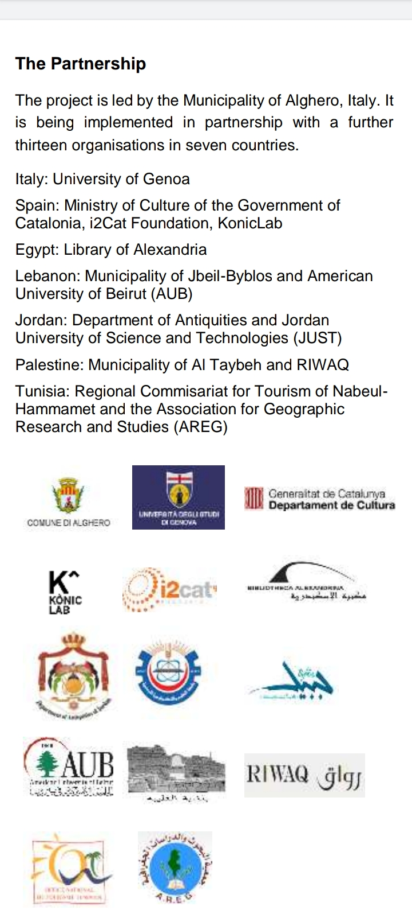
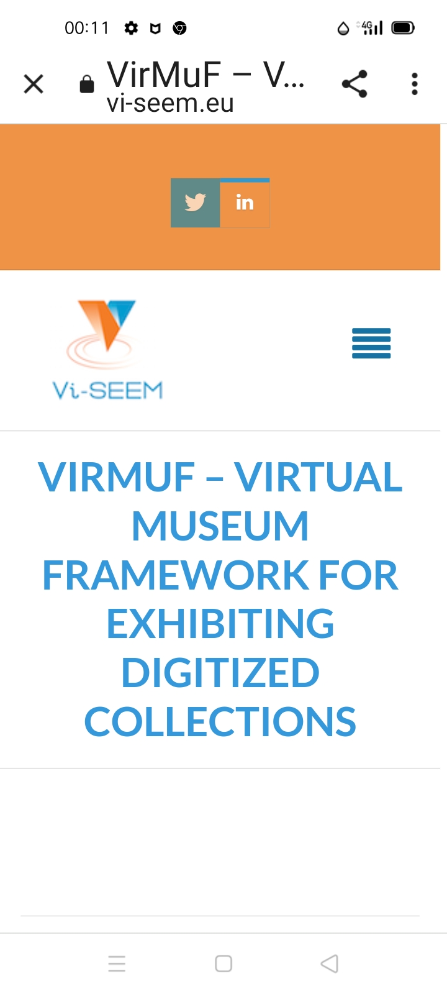
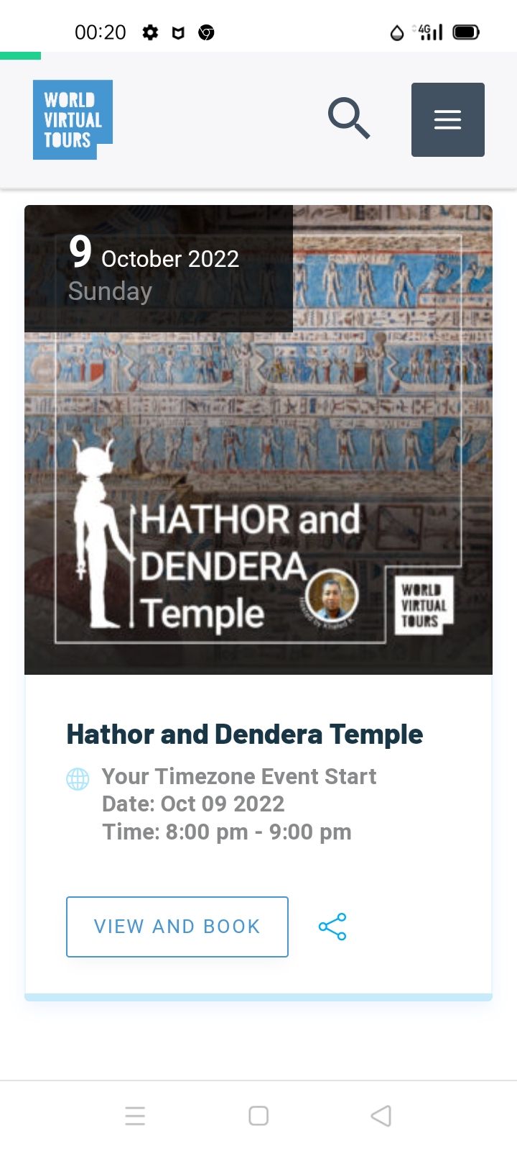
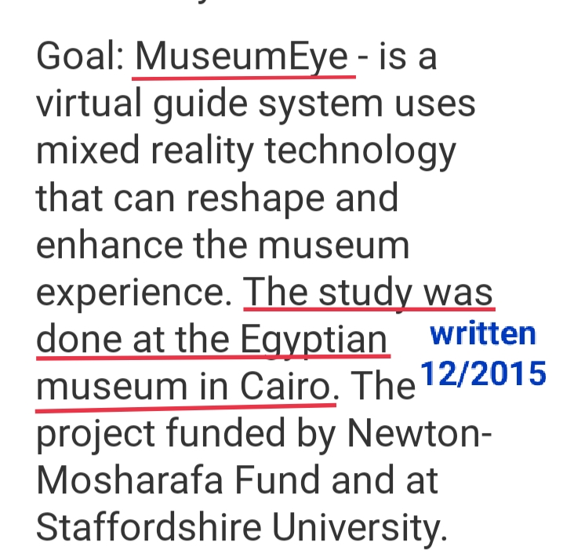
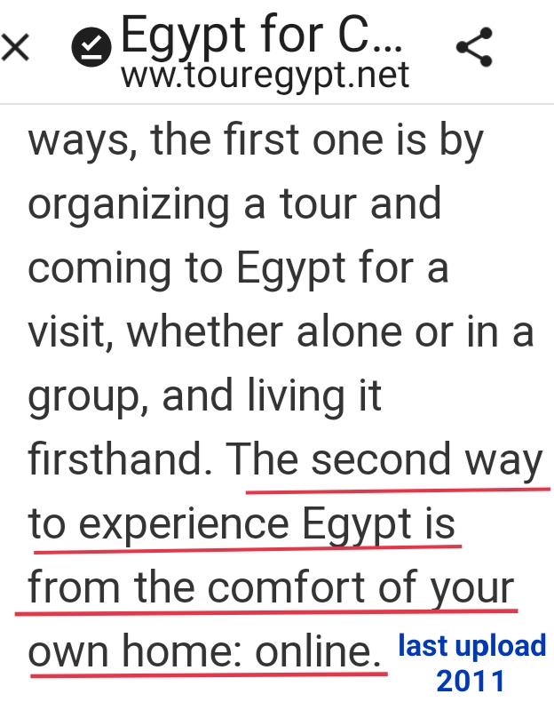
EU & AlexBib
2007-2013
Notes:
Don't we also have both previous & new trials of online & VR tourism to have the intuition to do it???

Slide 23
Research inside Egypt
https://www.researchgate.net/profile/Manar-Abdelhamid-2
https://www.unlock-bc.com/news/2021-03-09/two-arab-women-listed-among-top-21-blockchain-leaders/?amp
Research joint/abroad
https://youtu.be/lUPR89uBxQQ
https://youtu.be/yFwVST1KElg
https://a16z.com/author/ali-yahya/
https://lists.linuxfoundation.org/pipermail/bitcoin-dev/2022-September/020908.html
Trade
Crypto received~ $40bns
https://blog.chainalysis.com/reports/middle-east-north-africa-cryptocurrency-geography-report-2022-preview/
Banks
National Bank Egypt (nbe) begun a project to build a crypto-based remittance corridor between Egypt and the UAE
https://www.coindesk.com/business/2021/05/19/egypts-largest-bank-joins-ripple-network-for-cross-border-payments/

Slide 24
Challenges & Key Issues (Choices?)
Network readiness. ✔️
Human Resources. ✔️
Notes:
-We don't have to worry about all network problems happened in countries like Salvador, since our target customers are tourists around the world that will use their internet facilities most of the time not ours. -There are developers (graduates /yr), artists, applied arts, economists, lawyers ( I'll discuss copyrights after a couple of slides) -We have previous & current VR projects. -Any needed training will add to the human resources value; or network facilities in the same sense. . -Now let's move to the Blockchain choice

Slide 25
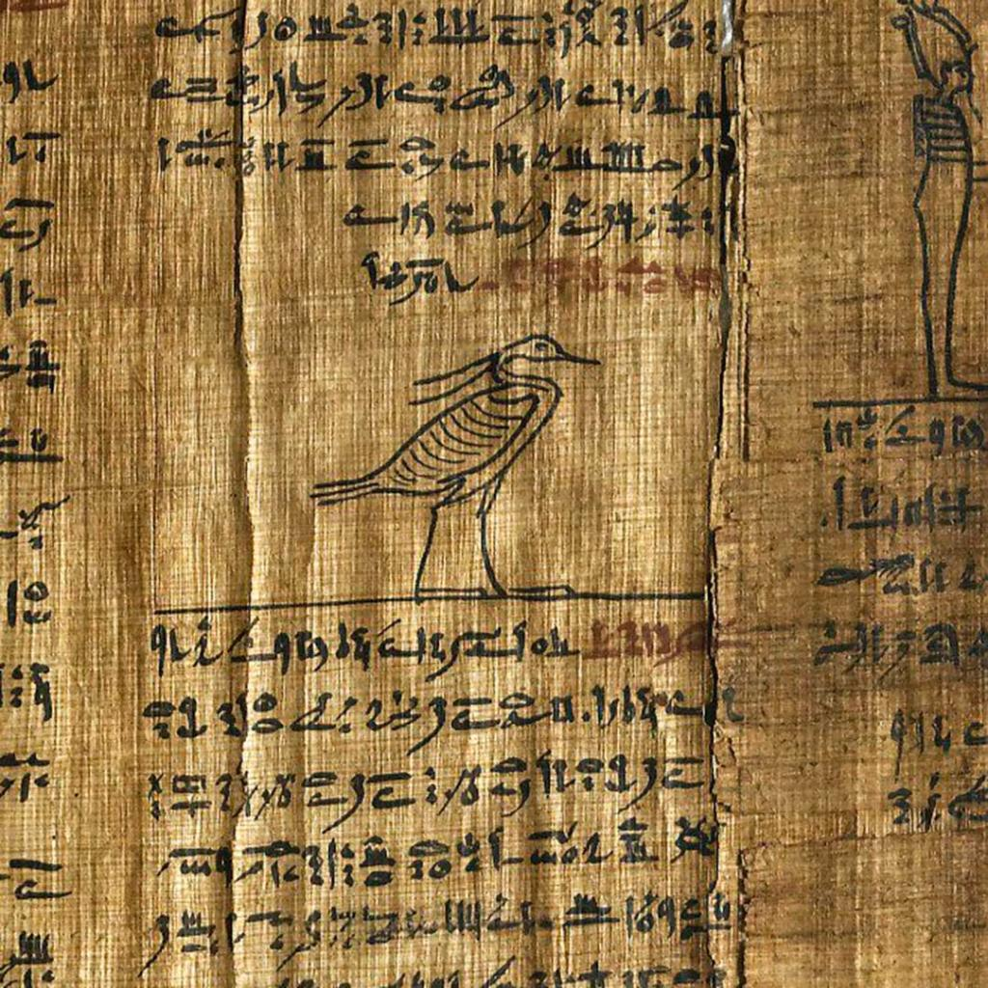
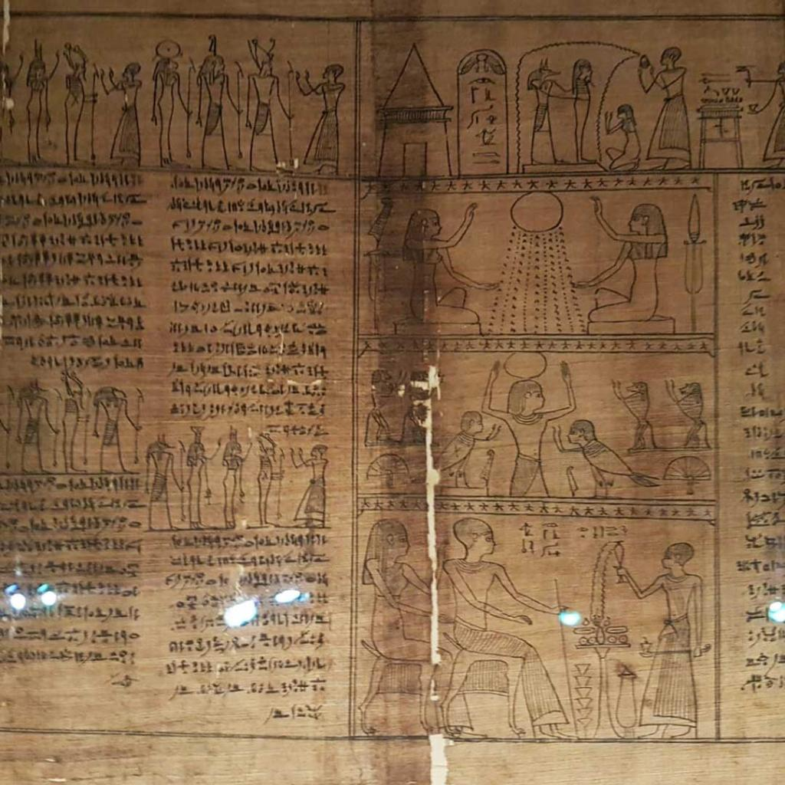
Economics
Previous NFTs price volatility curves, risk & return analysis don't apply directly here.
Could work only for History inspired games
New studies with tourism metrics included should be done
2 out of 8 crypto connections (25%), museum contains 1200/20,000 (6%) pieces from Egypt & Sudan
https://www.liverpoolmuseums.org.uk/collections/cryptoconnections

Slide 26
Economics
Free drops, moderate prices, expensive DAWs
Market clearance, fairness, geo-distribution
Royalties as a feedback, not just downstream sell ratio
Auctions kinds,
Notes:
-Economists should study market metrics & make their analysis regarding: 1-What to sell as expensive DAWs, what in moderate price, what in cheap, what and when to offer free drops 2-The number of each also to achieve market clearance, sense of fairness, and maybe Geo-distribution ( like what countries are more fond of Egypt, or what countries are harder to physically come due to distance or any other factors) >>>> Vitalik post, a16z group ( after getting market metrics, this falls in game theory research) . -Finally, use royalty to get extra profit + to trace selling patterns statistics and analyze them

Slide 27
Blockchain Choice
Ethereum created NFTs (still, possible in Bitcoin)
Criticisms for environmental damage
Favors POS vs POW
(Tezos, Solana, Cardano, Ethereum L2 POS)
Algorand : no cryptocurrency ➡️un-forkable
Make your own Blockchain
(DEN token, Shangbo chain)

Slide 28
Security & Privacy
Metaverses have the same VR /AR/XR vulnerabilities of inferring knowledge about its users.
MetaGuard new researc Berkely univesity
(C#) plugin that quantify ε-differential sensitivity for user data, then intelligently adding noise to maximize privacy while minimizing usability impact.
https://rdi.berkeley.edu/metaguard/
NFT attacks
(user's wallet, marketplace, creator, URL storage)

Slide 29
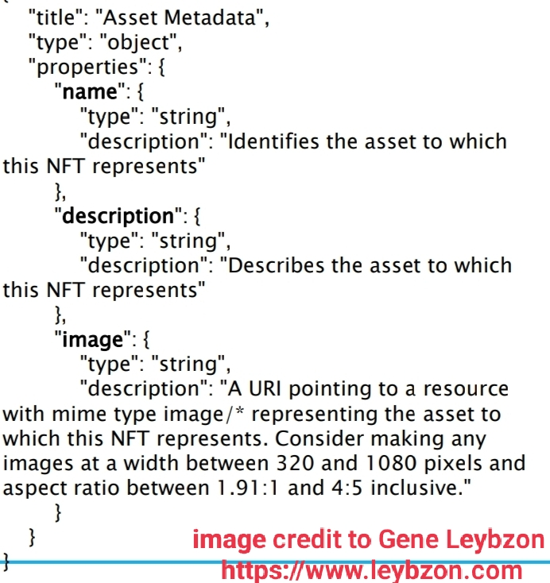
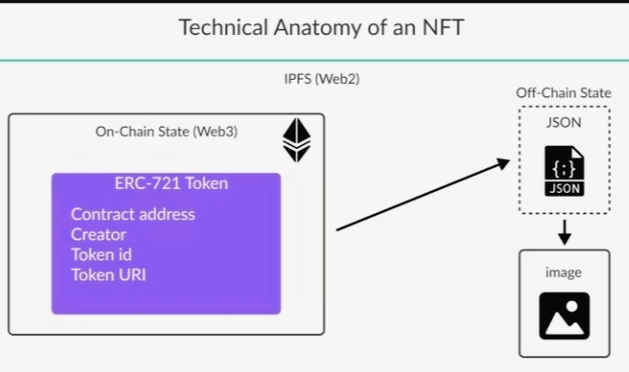
NFT Anatomy
A new token type by Ethereum, ERC-721, for Non-Fungible items (more attributes)
(earlier trials by Bitcoin 2012, colored coins )
Metadata
Royalty by the marketplace
Real image is stored off-chain

Slide 30
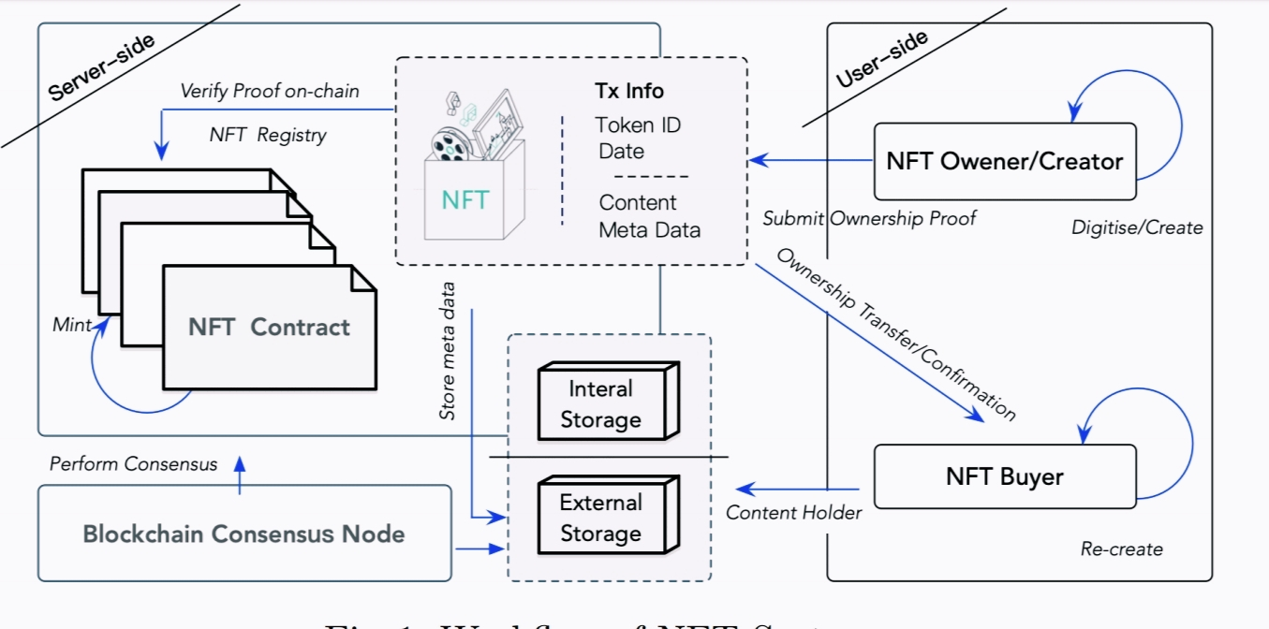

Slide 31
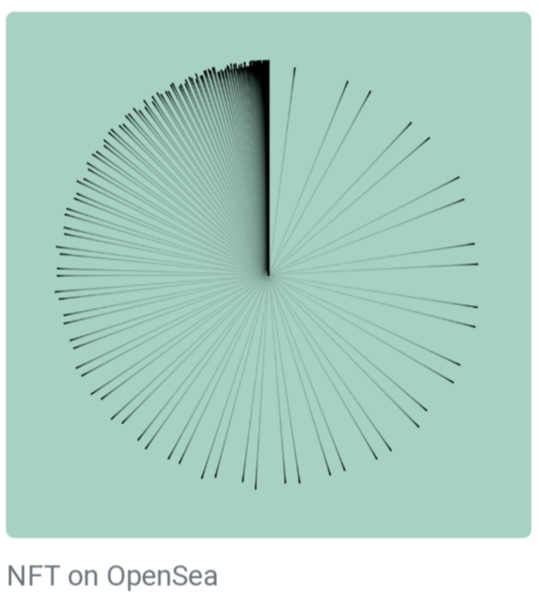
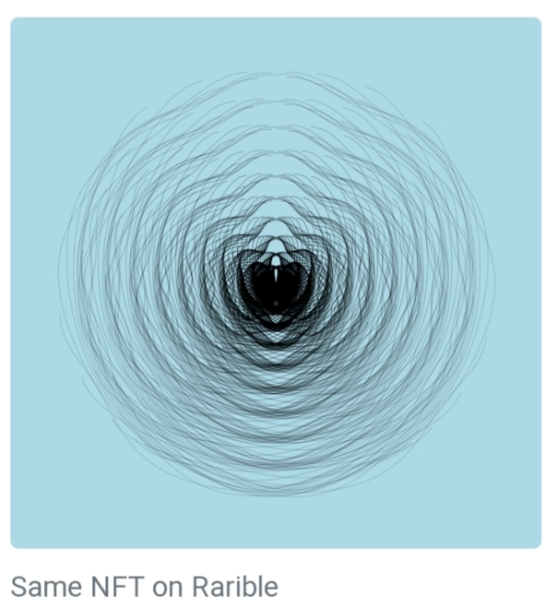
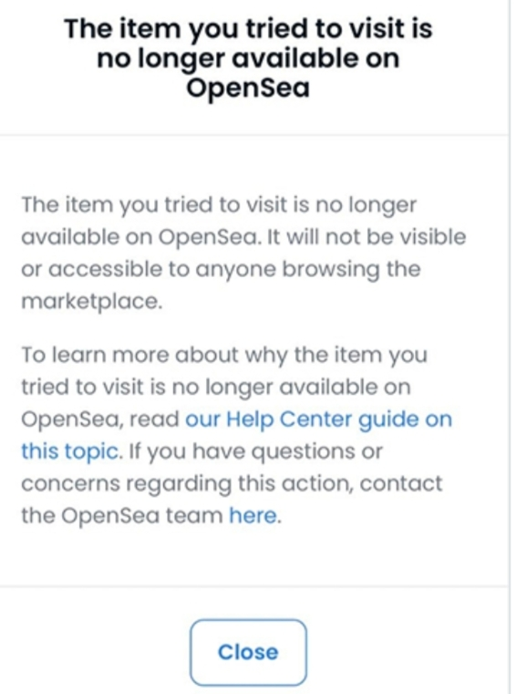
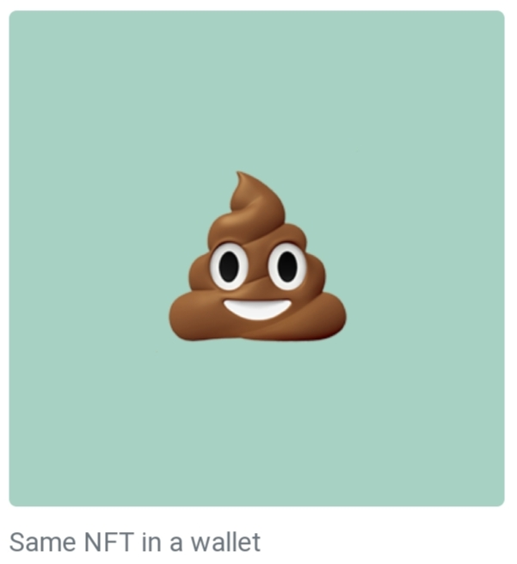
NFT Storage
https://moxie.org/2022/01/07/web3-first-impressions.html
on OpenSea
on Rarible
vanished a few days later
on user wallet

Slide 32
NFT Data Storage Options
Clouds: centralized, Amazon CloudFront, problems
IPFS (Interplanetary FileSystemt)
decentralized, problems
FileCoin rewards storage providers & retrivers in IPFS
Arweave
StateSnap
state-aware P2P network+ permissioned blockchain
Proliferation

Slide 33
Copyrights
Use only, no sell (valuables)
Use, sell, edit
Intellectual rights (World of Women WoW)
What rights are forwarded with downstream sell? What if changed it on their site? What if the company was bought (Yuga Labs)?
Moonbirds changing to CC0, owner filed lawsuit
Seth Green TV show with his Ape, commercial rights
Yuga metaverse no intellectual rights with re-sell
"Can't be Evil" codifying the rights of NFT creators, buyers, and sellers; irrevocable by creators
https://a16zcrypto.com/introducing-nft-licenses/

Slide 34
Liabilities & Regulations
The legal personality of robots has been a quest for legitimacy; avatars in the metaverse carry the same problems of artificial personality
https://link.springer.com/article/10.1365/s43439-022-00056-9
privacy, rights, and harm (sexual, pain, defamation,..)
Roblox https://www.bbc.com/news/technology-48450604
Meta (safezone bubble)
https://www.technologyreview.com/2021/12/16/1042516/the-metaverse-has-a-groping-problem/
MMORPGs hierarichy of in-game penalties
https://link.springer.com/article/10.1007/s10676-019-09498-y#:~:text=By%20exploiting%20the%20player%20controlling,be%20wrong%20on%20Kantian%20grounds.

Slide 35
Conclusions

Slide 36
"NFTs might act as a boost to support the creator economy.NFTs are highly innovative technologies,with a clear market value proposition, which might nurture a new techno-cultural movement. It is recommended that the EU supports NFTs through European projects aimed to promote culture, arts, and youth creativity. Generally,a clear European policy regarding NFTs will support entrepreneurs to choose EU member states as their base,while supporting the creation of new jobs in the EU"
The European Parliament report on NFTs

Slide 37
"The World Economic Forum is committed to bringing together leading voices from the private sector, civil society, academia, and policy to define the parameters of an economically viable, accessible, and inclusive metaverse"
The World Economic Forum

